Slide 1
Agenda
Database Patterns
Database Patterns
Database Per Service Pattern
Shared Database Pattern
CQRS Pattern
Saga Pattern

Slide 2
Database Patterns
Problem: While defining database architecture for microservices, the following concerns must be addressed:
  Services must be loosely coupled and developed, deployed, & scaled independently.
  Business transactions may enforce invariants that span multiple services.
  Some business transactions need to query data that is owned by multiple services.
Solution: There are the following patterns to rescue the above concerns:
  Database Per Service
  Shared Database
  CQRS (Command Query Responsibility Segregation)
  Saga Pattern

Slide 3
1. Database Per Service
One database per microservice must be designed; it must be private to that service only. It should be accessed by the microservice API only.
It cannot be accessed by other services directly.
Catalog Microservice
Authentication Microservice
Order Microservice

Slide 4
2. Shared Database
In this pattern, one database can be aligned with more than one microservice, but it has to be restricted to 2-3 max, otherwise scaling, autonomy, & independence will be challenging to execute.
An ideal solution for legacy applications.
Catalog Service
Database
Stock
Service
Notes:
When building applications, DDD talks about problems as domains and subdomains.
Identifying subdomains is not an easy task. It requires an understanding of the business. Like business capabilities, subdomains are identified by analyzing the business and its organizational structure and identifying the different areas of expertise.

Slide 5
3. Command Query Responsibility Segregation (CQRS)
Once we implement database-per-service, there is a requirement to query, which requires joint data from multiple services.
CQRS suggests splitting the application into two parts :
  Command side - Handles the Create, Update, and Delete requests.
  Query side - Handles the query part by using the materialized views.
Client Request
(Command, Query)
Database
Service
Client Request
(Command, Query)
Command Service
Database
Database
Query
Service
Standard, non-CQRS architecture
CQRS architecture
Notes:
When services are developed by decomposing business capabilities/subdomains, the services responsible for user experience have to pull data from several microservices.
The problem with traditional architectural patterns is that the same data model or DTO is used to query as well as update a data source. This can be the go-to approach when your application is related to just CRUD operations and nothing more. But when your requirements suddenly start getting complex, this basic approach can prove to be a disaster.
In practical applications, there is always a mismatch between the read and write forms of data, like the extra properties you may require to update. Parallel operations may even lead to data loss in the worst cases. That means, you will be stuck with just one Data Transfer Object for the entire lifetime of the application unless you choose to introduce yet another DTO, which in-turn may break your application architecture.
CQRS allows for separate data stores and models (data or ORM) for Commands and Queries. The data between data stores is usually synchronized asynchronously using a service bus.
An architecture that is built upon the CQS pattern will follow the same logical separation, but Queries and Commands will be executed on the same datastore and share the same model. It should be noted though that you can use CQS in an application that does not have a data store at all.
https://www.codewithmukesh.com/blog/cqrs-in-aspnet-core-3-1/#0-what-is-cqrs

Slide 6
4. Saga Pattern
Problem: When each service has its own database and a business transaction spans multiple services, how do we ensure data consistency across services?
Solution: Saga pattern is the solution.
A Saga is a sequence of local transactions where each local transaction updates the database and publishes a message or event to trigger the next local transaction. If a local transaction fails then the saga executes a series of compensating transactions that undo the changes made by the preceding local transactions.
Notes:
A Saga represents a high-level business process (such as booking a trip) that consists of several low-level Requests that each update data within a single service.
For example, for an e-commerce application where customers have a credit limit, the application must ensure that a new order will not exceed the customer’s credit limit. Since Orders and Customers are in different databases, the application cannot simply use a local ACID transaction.
https://blog.couchbase.com/saga-pattern-implement-business-transactions-using-microservices-part/
https://www.cloudamqp.com/blog/2019-12-12-when-to-use-rabbitmq-or-apache-kafka.html
https://www.upsolver.com/blog/kafka-versus-rabbitmq-architecture-performance-use-case

Slide 7
4.1 Saga Pattern Implementation
Confirm
Payment
Payment
(Confirm Payment)
Order
(Create Order)
Stock
(Reserve Stock
Saga Log
Start Order
End Payment
Saga Execution
Coordinator
(SEC)
Start
Create Order
Cancel
Payment
Cancel
Order
Release
Stock
End
Reserve Stock
Saga Flow
Saga Execution Coordinator
Notes:
Solving distributed transaction management problem in microservices architecture using Saga – IBM Developer

Slide 8
4.1 Saga Execution Coordinator
The Saga Execution Coordinator (SEC) maintains a Saga log that contains the sequence of events of a particular flow.
If a failure occurs within any of the components, the SEC queries the logs and helps identify which components are impacted and in which sequence the compensating transactions must be executed.
If the SEC component itself fails, it can read the SEC logs when coming back, to identify which of the components are successfully rolled back, identify which ones were pending, and start calling them in reverse chronological order.

Slide 9
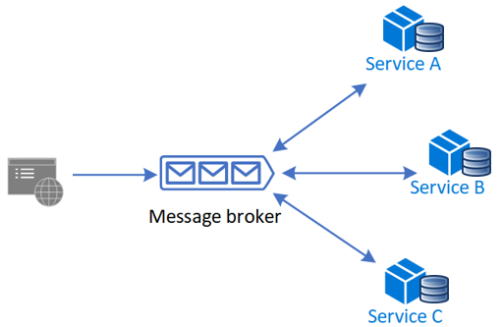
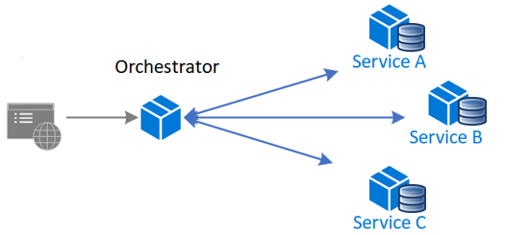
4.2 Saga Pattern Implementation
Choreography – each local transaction publishes domain events to the message broker that trigger local transactions in other services.
Orchestration – an orchestrator (object) tells the participants what local transaction to execute.
Notes:
Distributed Transactions in Microservices (dotnetuniversity.com)
Two Phase Commit:
Not really recommended for many microservice-based systems because 2pc is synchronous (blocking)
Reduce throughput due to locks
Not support by many NoSQL databases or message brokers
GitHub - Azure-Samples/saga-orchestration-serverless: An orchestration-based saga implementation reference in a serverless architecture

Slide 10
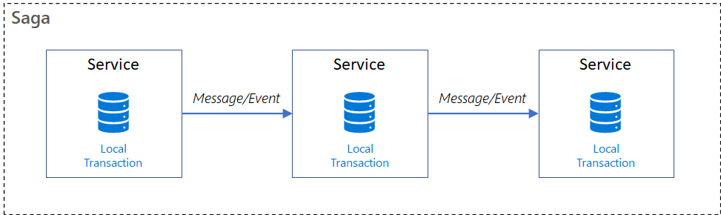
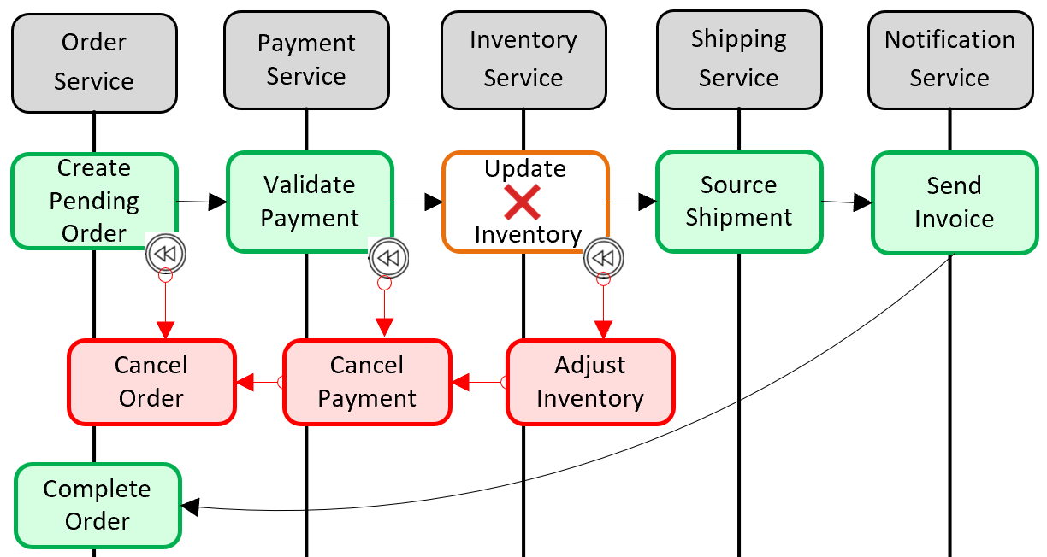
3.4.2 Saga Pattern Implementation
Notes:
Solving distributed transaction management problem in microservices architecture using Saga – IBM Developer
How to Create Distributed Transaction Using MassTransit in your .Net Core Micro-services | by Mortaza Ghahremani | Medium

